Slide 1

Application Development Using JavaFX and JDBC
Notes:
Hi, thank you for being here! …
[We recommend you give the workshop attendees a link to this presentation as there will be useful links included in the slides and notes]

Slide 2


Hi! I’m...
Siddhant Mishra
Senior Software Engineer Capgemini Technology Services India Limited
Notes:
Use this slide to introduce yourself, your background, what brought you to do this talk, etc.
Contact info can be included here as well

Slide 3
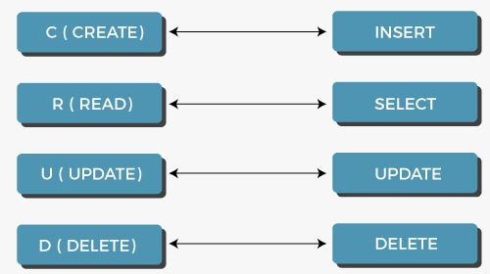
CRUD Operations in SQL
Notes:
Use this slide to introduce yourself, your background, what brought you to do this talk, etc.
Contact info can be included here as well

Slide 4
CREATE
Syntax:
CREATE TABLE Table_Name (ColumnName1 Datatype, ColumnName2 Datatype,..., ColumnNameN Datatype);
Example:
CREATE TABLE employee(ID INT PRIMARY KEY, First_Name VARCHAR(20), Last_Name VARCHAR(20), Salary INT, Email_Id VARCHAR(40));
Notes:
Use this slide to introduce yourself, your background, what brought you to do this talk, etc.
Contact info can be included here as well

Slide 5
INSERT
Syntax:
INSERT INTO Table_Name (ColumnName1,...., ColumnNameN) VALUES (Value 1,....,Value N),....., (Value 1,....,Value N);
Example:
INSERT INTO employee(ID, First_Name, Last_Name, Salary, Email_Id) VALUES (1, "Neeta", "Korade", 59000, "neetak12@gmail.com"), (2, "Sushma", "Singh", 62000, "sushsingh67@gmail.com"), (3, "Kavita", "Rathod", 27000, "kavitar09@gmail.com;
Notes:
Use this slide to introduce yourself, your background, what brought you to do this talk, etc.
Contact info can be included here as well

Slide 6
READ
Syntax:
SELECT * FROM TableName;
SELECT * FROM TableName WHERE CONDITION;
Example:
SELECT * FROM employee;
SELECT * FROM employee WHERE Salary > 35000;
Notes:
Use this slide to introduce yourself, your background, what brought you to do this talk, etc.
Contact info can be included here as well

Slide 7
UPDATE
Syntax:
UPDATE Table_Name SET ColumnName = Value WHERE CONDITION;
Example:
UPDATE employee SET Last_Name = "Bose" WHERE ID = 6;
UPDATE employee SET Salary = "35000", Email_Id= "shwetawagh03@gmail.com" WHERE ID = 10;
Notes:
Use this slide to introduce yourself, your background, what brought you to do this talk, etc.
Contact info can be included here as well

Slide 8
DELETE
Syntax:
DELETE FROM TableName;
DELETE FROM TableName WHERE CONDITION;
Example:
DELETE FROM employee WHERE Salary = 34000;
Notes:
Use this slide to introduce yourself, your background, what brought you to do this talk, etc.
Contact info can be included here as well

Slide 9
Thank You !
Email: siddhant.mishra0307@gmail.com
GitHub: https://github.com/sidjmishra
LinkedIn: https://www.linkedin.com/in/siddhant-mishra-021726181/

